Slide 1
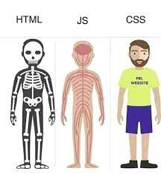
Frontend

Slide 2
HTML5
The Hypertext Markup Language or HTML is the standard markup language for documents designed to be displayed in a web browser. It can be assisted by technologies such as Cascading Style Sheets and scripting languages such as JavaScript
DEMO: famous websites with/out css/js

Slide 3
HTML TAG
Some Tags must have a start tag and closing tag ( <p></p> <h1></h1>)
Some Tags are self-closed (<br> <img/>)
Some tags have attributes (src, href, etc) – in start tag
Attributes are name-value pairs src=“image.jpg”
Some attributes are common to all tags

Slide 4
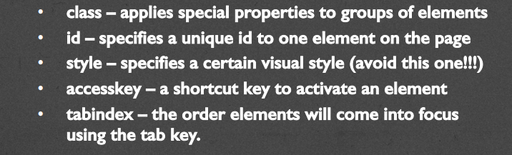
HTML TAG – common attributes

Slide 5
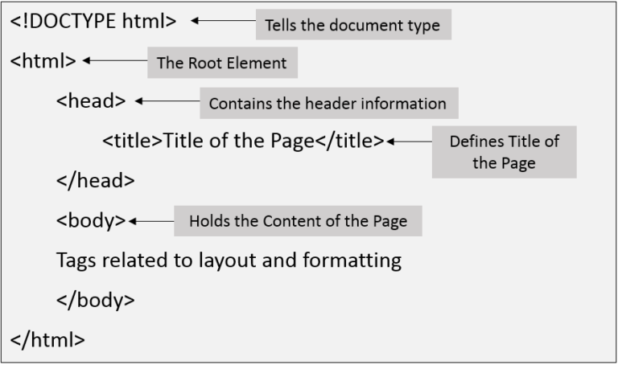
HTML5 (Page Structure)

Slide 6
HTML TAGS
Basic Tags: !doctype, html, head, body
Headings (h1-h6)
P, PRE, (strong,b),(em,i), (small)
Breaks (br, hr)
Anchors (a)
Image (img)
Lists (ul, ol, dl)
Table (tr,th,td)
Semantic Tags (div, section, article, aside)

Slide 7
HTML TAGS
Headings
Containers
Text
Lists
Links
Images
Objects
Tables
Forms
Semantic Tags

Slide 8
Links
https://www.w3schools.com/css/css_rwd_viewport.asp

